Slide 1
Hands on Flutter Workshop
App development Team

Slide 2
Dart
What is dart?
Dart is a statically typed, object-oriented programming language developed by Google which can be used to build web and mobile applications.

Slide 3
Dart
What is dart?
Statically Typed | Object-oriented | Mobile Applications
You define which type(s) of data a variable or function uses. | Everything‘s an object! You define classes as blueprints for your own objects. | Flutter uses Dart as a programming language to build native mobile apps.
String myName; myName = 'Max'; myName = 5; // Fails! | class Person { String name = 'Max'; } Person p = Person(); print(p.name); // 'Max'

Slide 4
Stateless vs Stateful
Stateless
Input Data
Widget
Renders UI

Slide 5
Stateless vs Stateful
Stateful
Input Data
Widget
Internal State
Renders UI

Slide 6
Stateless vs Stateful
Understanding State
In General
State is Data / Information used by your App
App Store
Authenticated Users
Landed Jobs
Widget State
Current User Input
Is a loading Spinner being shown?

Slide 7
Different Types of Widgets
Output & Input (Visible)
Layout & Control (Invisible)
RaisedButton(), Text(), Card()…
Row(), Column(), ListView()…
Container()
Drawn onto the screen:
“What the user sees”
Give your app structure and control how visible widgets are drawn onto the screen (incirectly visible)

Slide 8
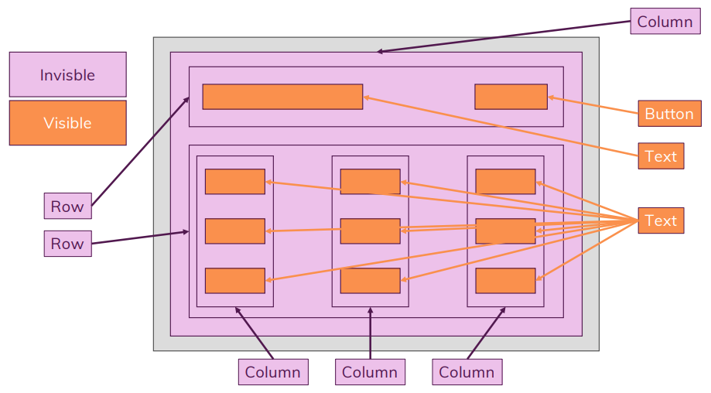
Visible vs Invisible Widgets

